Slide 1
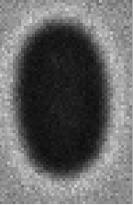
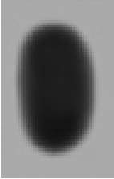
























































$$G_{1}$$
$$G_{2}$$
Training Generator(Simulation SEM to Simulation Depth)
Simulation SEM to Depth
Simulation SEM to Train SEM
fake B
$${Dis}_{G}$$
True/False
$$F_{1}$$
$$F_{2}$$
Real A
$$G_{1}$$
$$F_{1}$$
recon A
Real B
$$G_{1}$$
Idt A
Simulation Depth to SEM
Train SEM to Simulation SEM
Paired
Dataset
Simaultion
SEM Image
Guided$Loss_{G}$
$$Cycle Loss_{G}$$
$${Dis}_{F}$$
True/False
$$Identity Loss_{G}$$
$$F_{2}$$
$$G_{1}$$
Guided$Loss_{F}$
fake A
recon B
Real A
Idt B
최종 모델
Real B
$$F_{1}$$
$$G_{1}$$
$$F_{1}$$
Simaultion
Depth Image
$$Cycle Loss_{F}$$
$$Identity Loss_{F}$$
Training Generator(Simulation SEM to Train SEM)
fake B
$${Dis}_{G}$$
True/False
Real A
$$G_{1}$$
$$F_{1}$$
recon A
Real B
$$G_{1}$$
Idt A
Simaultion
SEM Image
$$Cycle Loss_{G}$$
$${Dis}_{F}$$
True/False
$$Identity Loss_{G}$$
Real B
$$F_{1}$$
fake A
$$G_{1}$$
recon B
Real A
Idt B
Train(Real)
SEM Image
$$F_{1}$$
$$Cycle Loss_{F}$$
$$Identity Loss_{F}$$
simulation sem to depth(S domain)
simulation to train(T domain)
$$F_{1}^{S}$$
$$F_{1}^{T}$$
case 1 training
$$G_{1}^{S}$$
case 1 training
$$G_{1}^{T}$$
Predict
case N
$$F_{2}^{S}$$
$$F_{2}^{T}$$
$$CNN classifier$$
$$G_{2}^{S}$$
$$G_{2}^{T}$$
Real Train
Image
case 2 training
$$F_{3}^{S}$$
case 2 training
$$F_{3}^{T}$$
$$F_{N}^{T}$$
$$G_{N}^{S}$$
case 3 training
$$G_{3}^{S}$$
case 3 training
$$G_{3}^{T}$$
predicted
simulation image
predicted
depth image
$$F_{4}^{S}$$
$$F_{4}^{T}$$
case 4 training
$$G_{4}^{S}$$
case 4 training
$$G_{4}^{T}$$

Slide 2
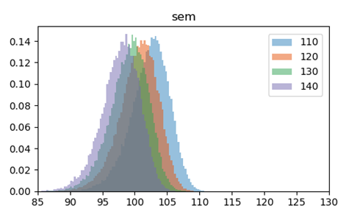
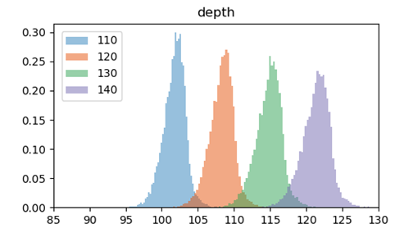
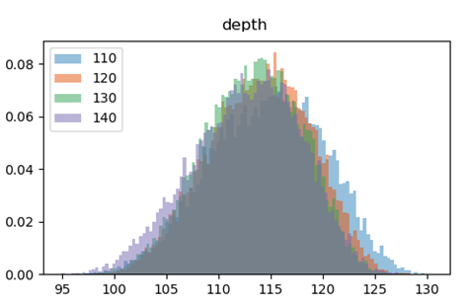
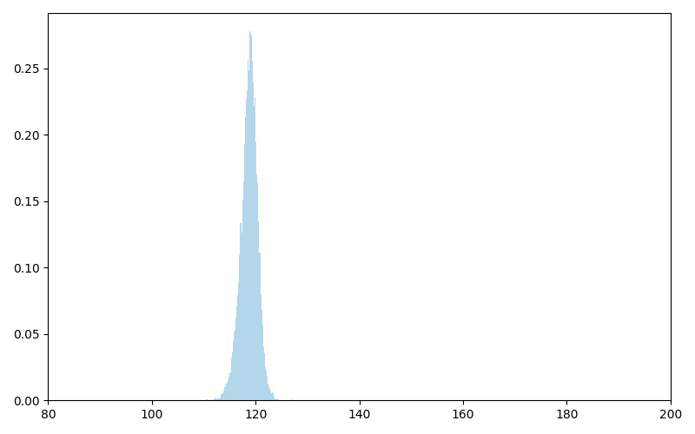
이미지 분포
원했던 결과
실제 학습 결과

